Slide 1
Influences on group behavior
Learning Intention: Understand how the presence of others impacts the behaviours of individuals within a group

Slide 2
Social Psychology Glossary
Social inhibition: reduced performance due to the presence of others.
Conformity: changing behaviour and attitude in response to group pressure.
Normative social influence: the pressure on an individual to change behaviour to conform to group standards in order to be accepted by the group.
Informational social influence: the pressure on individuals when in strange situations to behave in the manner of those around them.
Obedience: changing behaviour in response to instruction or direct request by an authority figure

Slide 3
Peer Pressure
Think of a situation where you have succumbed to peer pressure

Slide 4
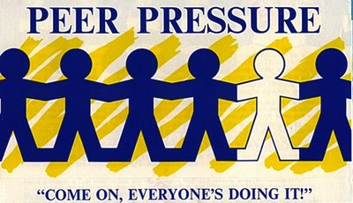
Social Influence
Changing behaviour in response to others.
Influence of a group is stronger if we identify with the group.
Peers – people who interact with us on fairly equal terms. They usually have the same status.
Peer and a friend is not the same thing

Slide 5

Peer groups
Peer groups have their own social norms that can cover things such as style, dress, taste in music, and attitudes to different topics.
May have their own slang terms or expressions that are not understood by others outside of the group.

Slide 6
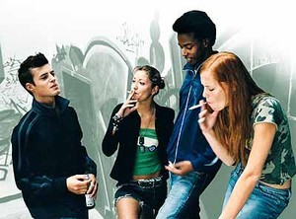
Peer pressure
Influence of peer groups starts to increase around middle childhood and continues until middle adolescence.
Peer pressure can have a negative label.
Pressure from groups or individuals to think, feel or behave in certain ways, whether they want to or not.

Slide 7

Conformity – (Asch 1955)
Changing behaviour in response to peer pressure.
Conform to be accepted by a group – known as normative social influence
Breaking social norms can lead to exclusion

Slide 8

Conformity
We often conform when we are in strange situations, around people we don’t know well or situations that are new to us. Known as informational social influence
Can you think of examples where you have had to conform?

Slide 9

Group size
Has an effect on conformity
Increases with group size up to a group of 3-5.
After that increasing group size has little effect

Slide 10
Degree of unanimity
When the others in the group are unanimous – agree completely – it is difficult for an individual to stand out.
Asch (1955) found that the presence of another person who share’s one view or does not agree with others strengthens resistance to conformity.

Slide 11
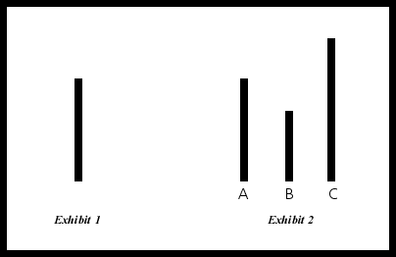
Asch’s line judgement task

